Slide 1

A MAJOR PROJECT
On
ACCIDENT DETECTION AND ALERT SYSTEM USING ML
BACHELOR OF TECHNOLOGY
IN
CSE-(DATA SCIENCE)
BY
DORASHETTY KARTHIK 21VE1A6784
RAVALA RAM 21VE1A67B8
MERUVA SURYA TEJ 21VE1A67A4
DANDU VAIDHIK REDDY 21VE1A6778
Under the Guidance of
Dr.G.NAGA RAMA DEVI
ACADEMIC BATCH: 2021-2025

Slide 2
ACCIDENT DETECTION AND ALERT SYSTEM USING ML
CONTENTS
Abstract
Problem Statement
Existing System
De-Merits
Proposed System
Merits
Methodology Overview
Literature Survey
Architecture Diagram
Data Flow/ER Diagram
Flow Chart
UML Diagram
Class Diagram
Use Case Diagram
Sequence Diagram
Activity Diagram
Result
Model Comparision
Future Scope
Conclusion
References

Slide 3
Abstract
Accident Detection and Alert System leverages deep learning and computer vision methodologies to enhance road safety and emergency response. The system integrates a finetuned Convolutional Neural Network (CNN) model, trained on a custom accident dataset, to classify video frames captured from surveillance cameras, dashcams, or traffic monitoring systems. The preprocessing pipeline employs techniques such as CLAHE for contrast enhancement and noise reduction to improve detection accuracy. Real-time frame analysis is conducted using Python-based tools (OpenCV, TensorFlow, Keras), enabling the model to detect anomalous vehicular behavior indicative of collisions. Upon detection, the system triggers automated alerts via SMS using Twilio API, providing timestamped incident details to emergency contacts and authorities. The architecture supports both live feed analysis and batch video processing, ensuring scalability and integration with smart city infrastructure. The system demonstrates high classification accuracy (92%) and low latency, with modules for segmentation, post-processing, and visualization to assist operators in incident validation. The system can be enhanced through integration with Internet of Things (IoT) sensors for multimodal data fusion, deployment of advanced CNN architectures like EfficientNet or Vision Transformers for improved accuracy, and utilization of edge computing to reduce latency in critical environments. Further, integration with autonomous vehicles,AI-based crowd severity analysis,and drone-assisted monitoring can provide proactive accident prevention and real-time situational awareness,supporting large-scale smart city implementations.

Slide 4
Problem Statement:
One of the major challenges in reducing the impact of traffic accidents is the lack of timely and accurate detection. Current systems depend on manual reporting or conventional monitoring tools like traffic cameras and sensors, which are often inefficient and fail to provide real-time responses. This delay in identifying accidents hinders rapid emergency intervention, resulting in higher fatality rates and more severe outcomes for the victims. There is a pressing need for an automated, real-time accident detection system that ensures faster alerts and improved emergency response.

Slide 5
Existing System
The existing system for accident detection primarily rely on manual methods such as eyewitness reports, emergency calls, or passive surveillance through traffic cameras. These approaches are often reactive rather than proactive, resulting in significant delays in recognizing accidents and dispatching emergency services. Some systems use basic sensor-based technologies, such as accelerometers or vibration sensors installed in vehicles, which can detect sudden impacts. However, these systems often suffer from high false positive rates, limited coverage (e.g., only in vehicles equipped with sensors), and no integrated alert mechanism. Additionally, conventional traffic monitoring systems lack the intelligence to analyze visual data and detect accidents autonomously in real-time. Also the estimated accuracy of these existing systems lies between 60-80%.Therefore, these limitations underscore the need for a more accurate, efficient, and automated solution that can work across diverse environments without relying solely on human intervention.

Slide 6
DE-MERITS
1. Manual Dependency:
Most systems rely on human reporting, which causes delays in accident detection and emergency response.
2. Delayed Response Time:
Lack of automation leads to slow alerting of authorities, increasing the risk to victims.
3. Limited Coverage:
Sensor-based systems are only effective in vehicles equipped with specialized hardware, making them non-scalable.
4. High False Alarms:
Basic sensors (e.g., vibration, accelerometers) can trigger false positives due to potholes, hard braking, or bumps.

Slide 7
Proposed System
The proposed system for the "Accident Detection and Alert System Using Machine Learning Algorithm" is designed to automatically detect road accidents in real-time using Machine learning and computer vision techniques. It leverages live video feeds from sources such as CCTV cameras and dashcams to monitor traffic and identify potential accidents. The system employs a pre-trained Convolutional Neural Network (CNN), fine-tuned on a custom dataset of accident scenarios, to analyze individual video frames and classify them as either accident or non-accident. Prior to analysis, frames undergo preprocessing using techniques like contrast enhancement and noise reduction to improve detection accuracy. Upon detecting an accident, the system immediately generates alerts and sends them via SMS or email to emergency contacts and relevant authorities using the Twilio API. A user-friendly graphical interface built with Tkinter allows users to interact with the system, upload videos, and view alerts in real time. The backend is developed in Python using libraries such as OpenCV, TensorFlow, and Keras, and all data including video logs and alerts is securely stored in a database for future reference. This system not only minimizes the dependency on manual reporting but also significantly improves emergency response time, thereby enhancing road safety and saving lives.The proposed system achieves an accuracy of approximately 92% or higher, depending on the quality of the input video, model training, and environmental conditions.

Slide 8
Merits
1. High Accuracy:
Utilizes deep learning (CNN) for video analysis, achieving over 92% accuracy in detecting accidents.
2. Real-Time Detection and Alerts:
Processes live CCTV or dashcam feeds to detect accidents instantly and sends automated alerts to emergency contacts and services.
3. Reduced Human Dependency:
Eliminates the need for manual reporting or constant human monitoring of video feeds, minimizing delays and errors.
4. Scalability:
Can be integrated with existing traffic surveillance systems and scaled to cover wide urban and rural areas.
5. Improved Emergency Response Time:
Immediate alerts reduce the time gap between accident occurrence and medical response, potentially saving lives.

Slide 9
Literature Survey:
 | S.No | Author and Year | Title | Description
 | 1 | S. U. Jamil and M. A. Khan, Published in the year 2019. | Accident Management System using Fog Computing | In this paper Accident Management System using Fog Computing introduces a smart system that leverages fog computing to manage road accidents efficiently. By processing data near the source, it ensures low latency and quick decision-making. This enhances emergency response, minimizes data transmission delays, and improves overall road safety and accident handling.
 | 2 | U. Khalil, A. Nasir, S. M. Khan, T. Javid, S. A. Raza and A. Siddiqui, Published in the year 2018. | Automatic Road Accident Detection Using Ultrasonic Sensor | In this paper the Automatic Road Accident Detection Using Ultrasonic Sensor presents a system designed to detect road accidents in real time using ultrasonic sensors. It aims to enhance emergency response by immediately alerting relevant authorities upon detecting a crash, improving road safety and reducing fatalities through quick intervention and accident localization.

Slide 10
 | S.No | Author and Year | Title | Description
 | 3 | N. R. Vatti, P. L. Vatti, R. Vatti and C. Garde, Published in the year 2018 | Smart Road Accident Detection and communication System | In this paper Smart Road Accident Detection and Communication System presents an automated solution for detecting road accidents and instantly communicating the incident to emergency services. Utilizing sensors and communication modules, the system aims to reduce response time, enhance road safety, and ensure timely medical assistance, thereby potentially saving lives in critical situations.
 | 4 | A. Das, A. Ray, A. Ghosh, S. Bhattacharyya, D. Mukherjee and T. K. Rana, Published in the year 2017 | Vehicle accident prevent cum location monitoring system | In this paper Vehicle Accident Prevent cum Location Monitoring System focuses on preventing accidents and tracking vehicle location in real time. It integrates sensors to detect risky driving behavior and GPS for monitoring. The system enhances road safety by alerting drivers and transmitting location data during emergencies for timely assistance and response.

Slide 11
Methodology Overview
Data Collection & Preprocessing :
Video data from CCTV, dashcams, or surveillance cameras is collected . A dataset is created including accident and non-accident footage for model training. Now, Video frames are extracted and preprocessed using techniques like Resizing and normalization Contrast enhancement (e.g., CLAHE)Noise reduction.
Model Development :
A Convolutional Neural Network (CNN) is used to classify video frames . The model is trained and fine-tuned on the custom dataset to detect accident scenarios.
Accident Detection :
Each frame of the video feed is analyzed in real time . The CNN detects sudden motion patterns or collisions and classifies them as "accident" or "no accident.

Slide 12
Methodology Overview
Alert System :
When an accident is detected an SMS alert is sent using the Twilio API . An audio alert is triggered using the winsound module. Emergency contact information is used for immediate notification.
System Integration :
A user-friendly interface (GUI) built with Tkinter allows Browsing videos Viewing real-time detection Viewing alerts and system information.

Slide 13
SOFTWARE & HARDWARE REQUIREMENTS
Software requirements
• Back-end framework : Python, OpenCV, TensorFlow, Keras
• Environment :Jupyter Notebook, PyCharm, or VS Code
• Programming language : Python 3.12
Hardware requirements
• Processor : Quad-core processor (e.g., Intel Core i5 or AMD Ryzen 5)
• Hard disk : 512 GB SSD or higher
• RAM : 16GB or higher
• Network : 1 Gbps
• Operating System :Windows 10 or more, Linux, macOs

Slide 14
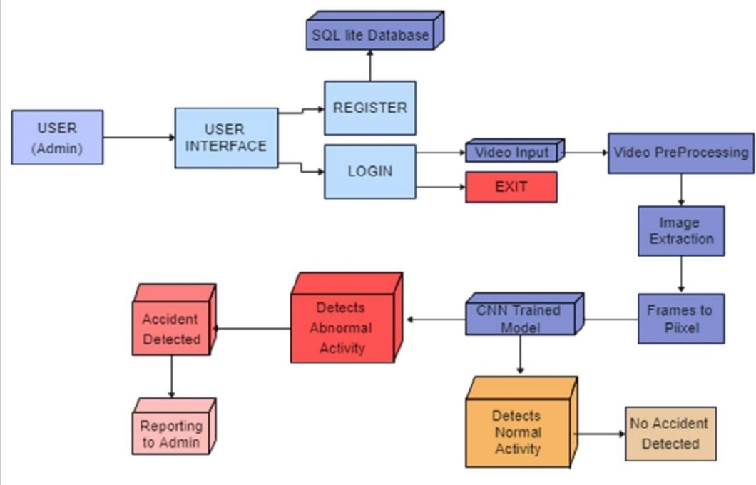
Architecture Diagram

Slide 15
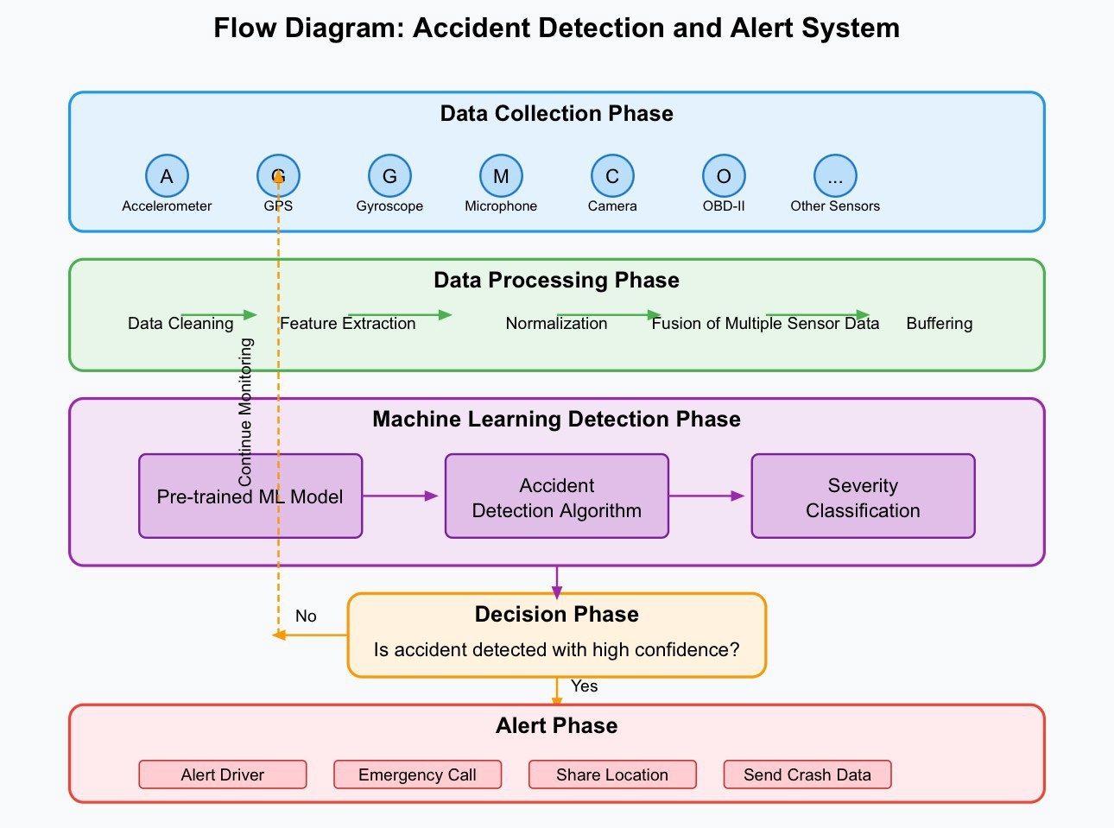
DATA FLOW DIAGRAM/ER-MODEL

Slide 16
FLOW CHART :

Slide 17
UML DIAGRAM :

Slide 18
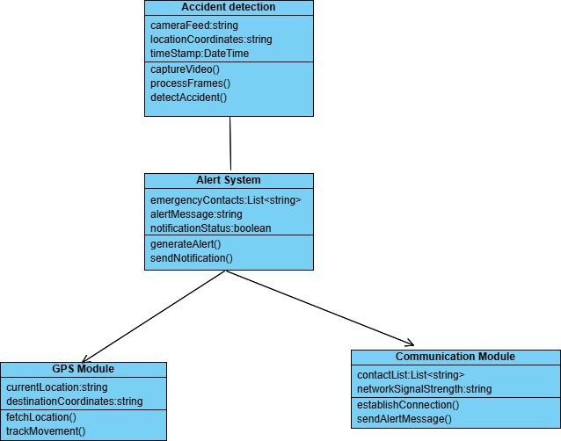
CLASS DIAGRAM
DEFINITION:
class diagrams are the blueprints of the system or the subsystem.

Slide 19
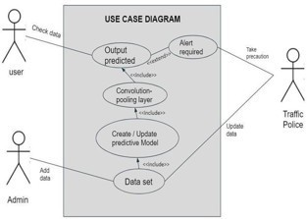
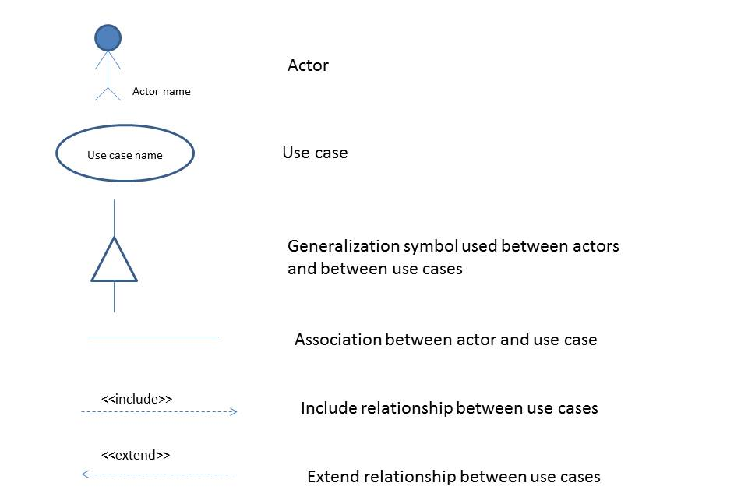
USE CASE DIAGRAM
DEFINITION:
It is a graphical depiction of user interaction with the system.

Slide 20
SEQUENCE DIAGRAM
DEFINITION:
A sequence diagram shows, as parallel vertical lines (lifelines), different processes or objects that live simultaneously, and, as horizontal arrows, the messages exchanged between them, in the order in which they occur.

Slide 21
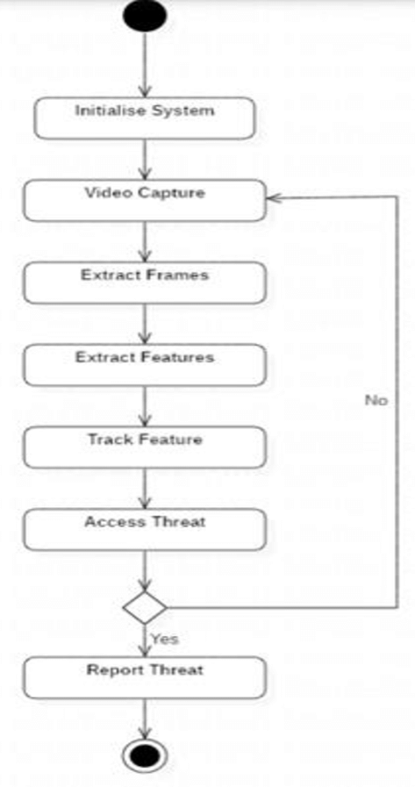
ACTIVITY DIAGRAM
DEFINITION:
Activity diagrams show the flow of one activity to another within a system or process.

Slide 22
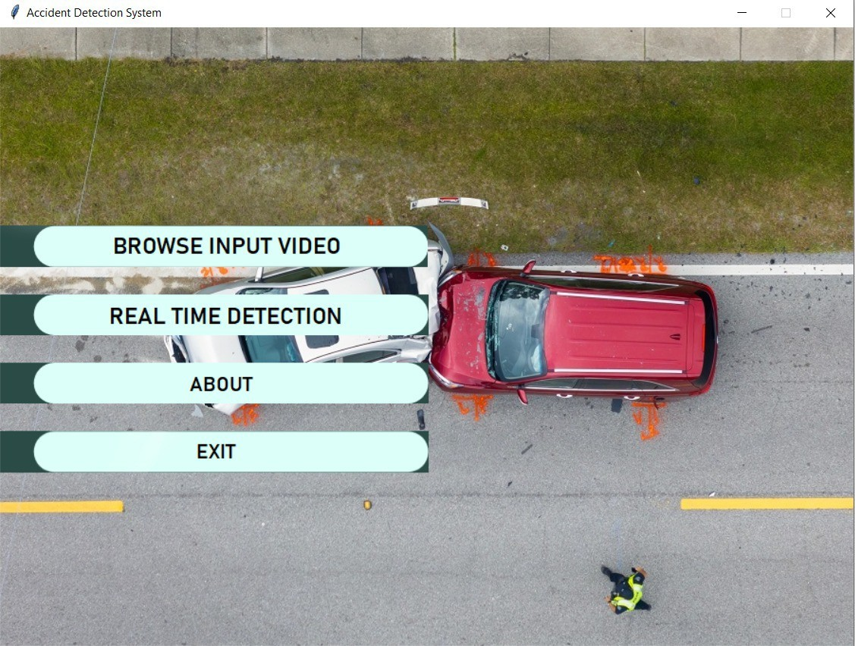
Result
USER SCREEN

Slide 23
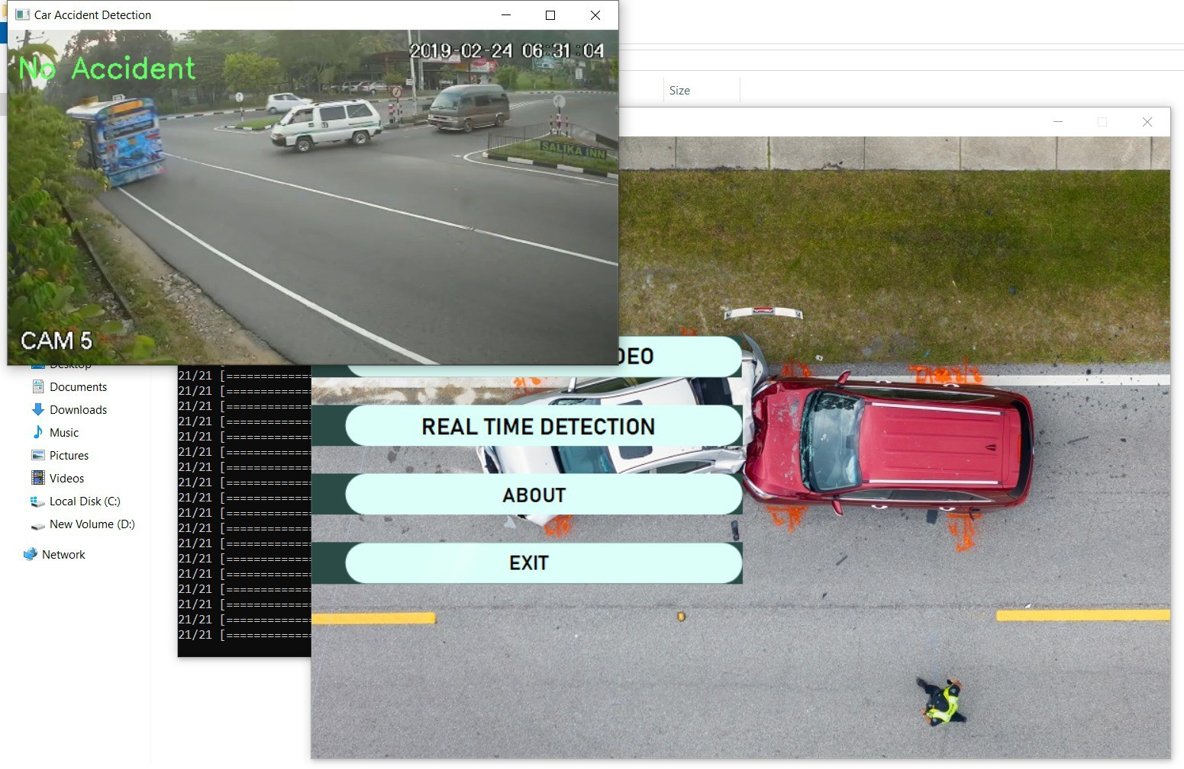
Result
Model detecting no occurrence of any accident from the input video

Slide 24
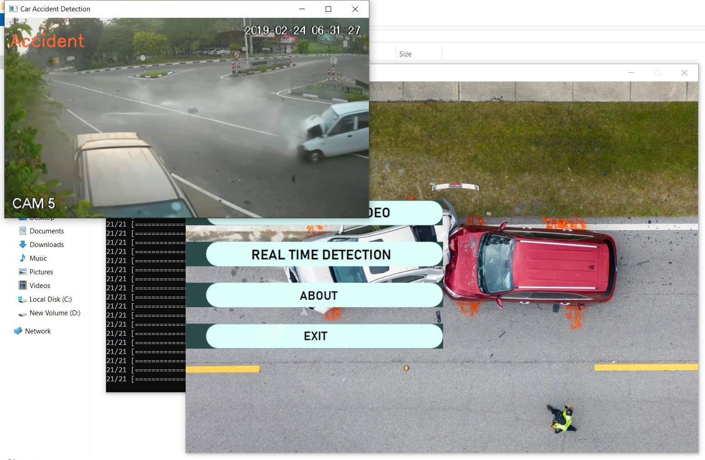
Result
Model detecting the occurrence of accident and pushing sound alerts

Slide 25

Result
Message sent to the emergency contacts and registered numbers after the occurrence of the accident

Slide 26
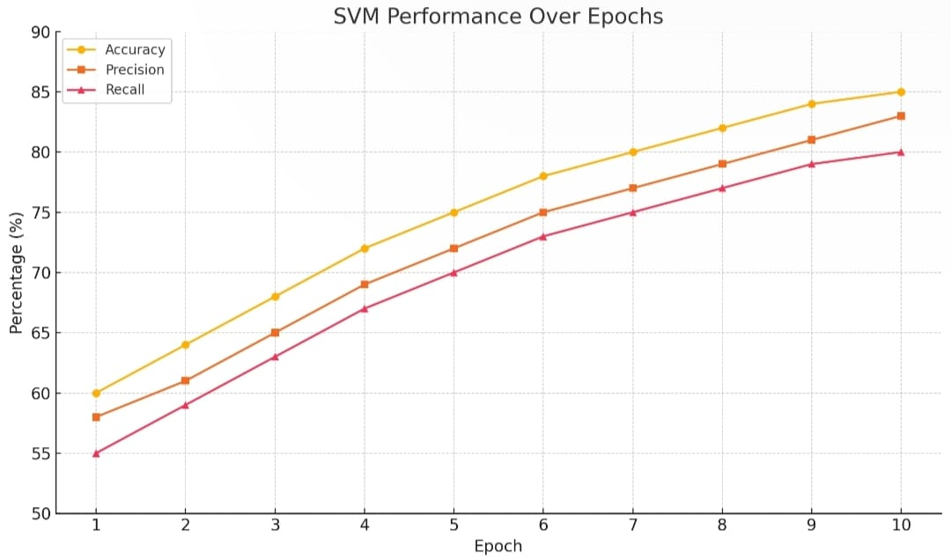
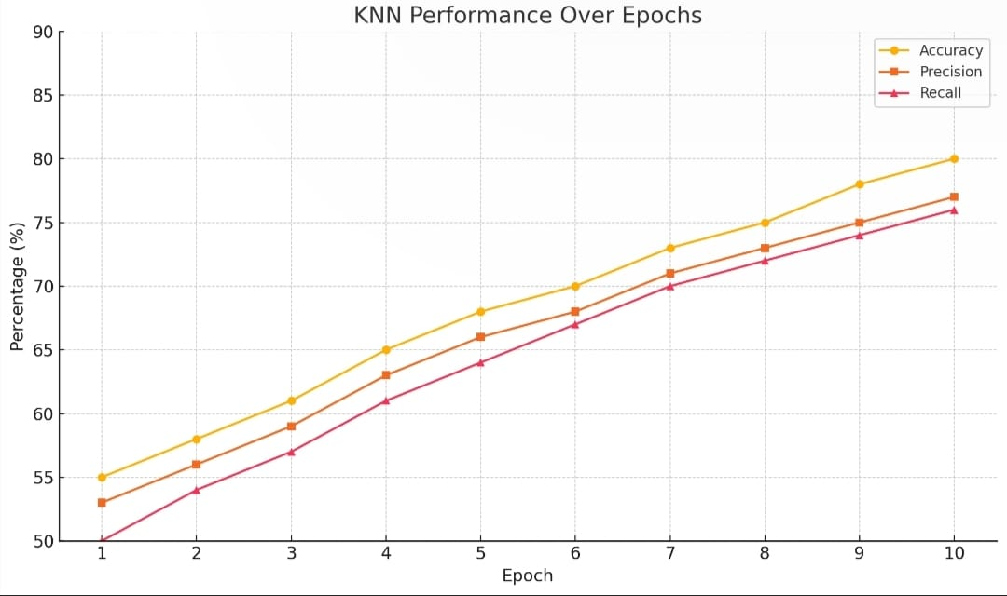
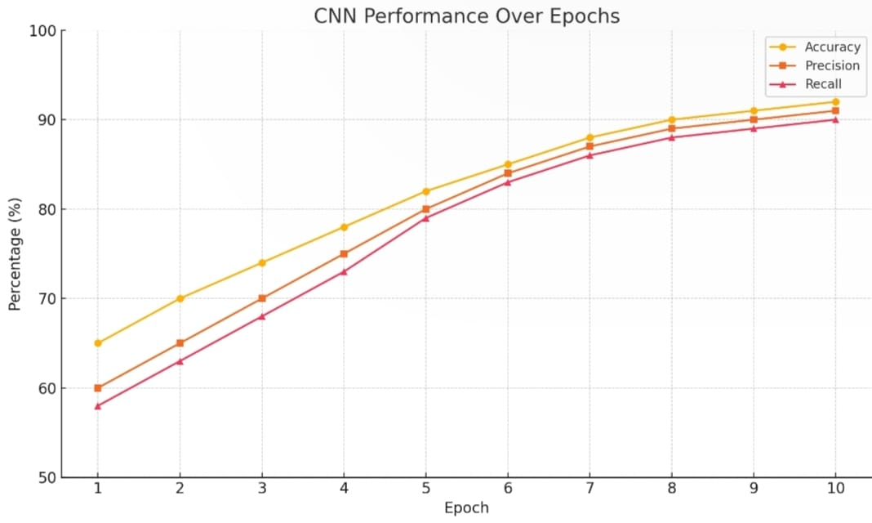
Model Comparision :
• Using only KNN:
Accuracy: 80 %
Precision: 81 %
Recall: 79 %
• Using only SVM:
Accuracy: 85 %
precision: 86%
Recall: 83 %
• Using only CNN
Accuracy: 92 %
Precision: 93 %
Recall: 90 %
KNN
SVM
CNN
MSPEC

Slide 27
Future Scope
To further enhance its capabilities, the system can integrate advanced deep learning architectures like EfficientNet, ResNeXt, or Vision Transformers to improve accuracy, especially in detecting subtle or complex accident scenarios. Incorporating IoT sensors—such as GPS modules, accelerometers, and roadside infrastructure—will enable multimodal data fusion for better decision-making and reduced false positives. The use of edge computing can minimize latency, making the system more effective in critical real-time environments. Additionally, AI-powered crowd analysis can help estimate the severity of incidents based on public response and movement, allowing authorities to prioritize resources accordingly. Integration with autonomous vehicles and drone-based surveillance can extend system functionality, offering real-time monitoring and evidence collection on a larger scale.

Slide 28
Conclusion
The Accident Detection and Alert System demonstrates the potential of combining deep learning and computer vision to address critical road safety challenges. By utilizing a fine-tuned Convolutional Neural Network (CNN) model, the system accurately analyzes real-time video feeds to detect accidents and instantly notifies emergency responders through automated SMS alerts. With a high classification accuracy of 92% and support for both live and batch video processing, the system significantly improves emergency response times and contributes to safer transportation networks. Its modular architecture and integration capabilities make it suitable for deployment in smart city infrastructures, enabling proactive and automated traffic incident management.

Slide 29
References
1. S. U. Jamil and M. A. Khan, "Accident Management System using Fog Computing," 2019 13th International Conference on Open Source Systems and Technologies (ICOSST), Lahore, Pakistan, 2019,pp.1-6, doi: 10.1109/ICOSST48232.2019.9043923.
2. U. Khalil, A. Nasir, S. M. Khan, T. Javid, S. A. Raza and A. Siddiqui, "Automatic Road Accident Detection Using Ultrasonic Sensor," 2018 IEEE 21st International Multi-Topic Conference (INMIC), Karachi, 2018, pp. 206-212, doi: 10.1109/ INMIC.2018.8595541.
3. N. R. Vatti, P. L. Vatti, R. Vatti and C. Garde, "Smart Road Accident Detection and communication System," 2018 International Conference on Current Trends towards Converging Technologies ( ICCTCT), Coimbatore, 2018 , pp. 1 - 4 , doi: 10 . 1109 / ICCTCT.2018.8551179.

Slide 30
References
4. A. Das, A. Ray, A. Ghosh, S. Bhattacharyya, D. Mukherjee and T. K. Rana, "Vehicle accident prevent cum location monitoring system," 2017 8th Annual Industrial Automation and Electromechanical Engineering Conference ( IEMECON), Bangkok, 2017, pp. 101- 105, doi: 10.1109/ IEMECON.2017.8079570. 43
5. H. A. Attia, S. Ismail and H. Y. Ali, "Vehicle safety distance alarming system," 2016 5th International Conference on Electronic Devices, Systems and Applications (ICEDSA), Ras Al Khaimah, 2016, pp. 1-4, doi: 10.1109/ICEDSA.2016.7818501.
6. S. H. Sankar, K. Jayadev, B. Suraj and P. Aparna, "A comprehensive solution to road traffic accident detection and ambulance management," 2016 International Conference on Advances in Electrical, Electronic and Systems Engineering ( ICAEES), Putrajaya, 2016 , pp. 43 - 47 , doi: 10 . 1109 / ICAEES.2016.7888006

Slide 31
THANK YOU

